Slide 1





PlantNest A perfect website for garden lovers
Made by team
Group member:
Nguyễn Hữu Dũng
Trần Thành Đạt
Đinh Doanh Việt
Trần văn Tiến
Bùi Mạnh Hùng

Slide 2
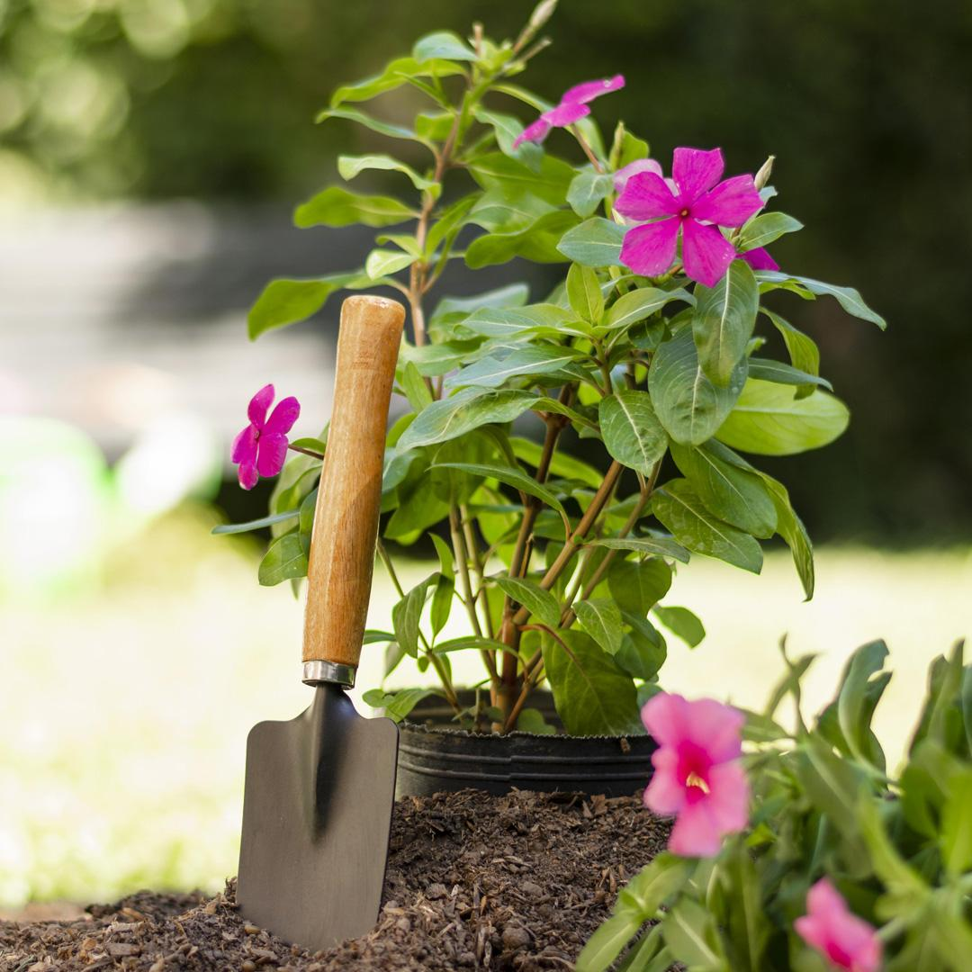
Purposes
To make a solution for what we said before, a website called PlantNest can provide users with information, shopping online for any customers who have an interest in plants, gardening,...

Slide 3
What we used create to the website was ?
HTML
CSS
JavaScript
A standard markup language for Web pages.
A language we use to style an HTML document.
The world's most popular programming language.
Laravel 10
Node.Js
Bootstrap
A web application framework with expressive, elegant syntax.
A JavaScript runtime built on Chrome's V8 JavaScript engine.
Most famous style pages

Slide 4
02
Function
What can this website do ?

Slide 5

Maybe you need to divide the content
Admin
User
Have the highest level of access to an account.
Limited access to the account as per the permissions given by the Admin.

Slide 6






What can user do ?
Login to website
Manage profile
Sign up / Sign in
Customize your profile base on your hobby
View
Search / Filter
View products
View categories
Search what you like
Contact support
Buy
Buy
Call for support
Shopping online

Slide 7
Admin
Can do what user can do
Manage products (CRUD)
Manage users
Manage categories
Read reviews / feedbacks

Slide 8
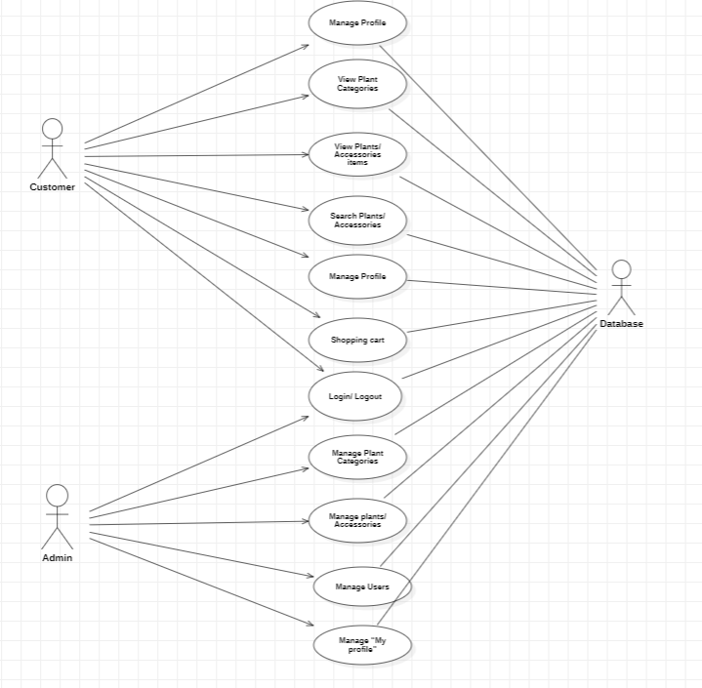
Use case

Slide 9
03
How it works ?

Slide 10



Procedure
25%
50%
75%
Begin
Middle
End
User sign up / sign in and buy some products
System will check products availble ,confirm check out and send it to admin
Admin receive notification and will provide products to users

Slide 11
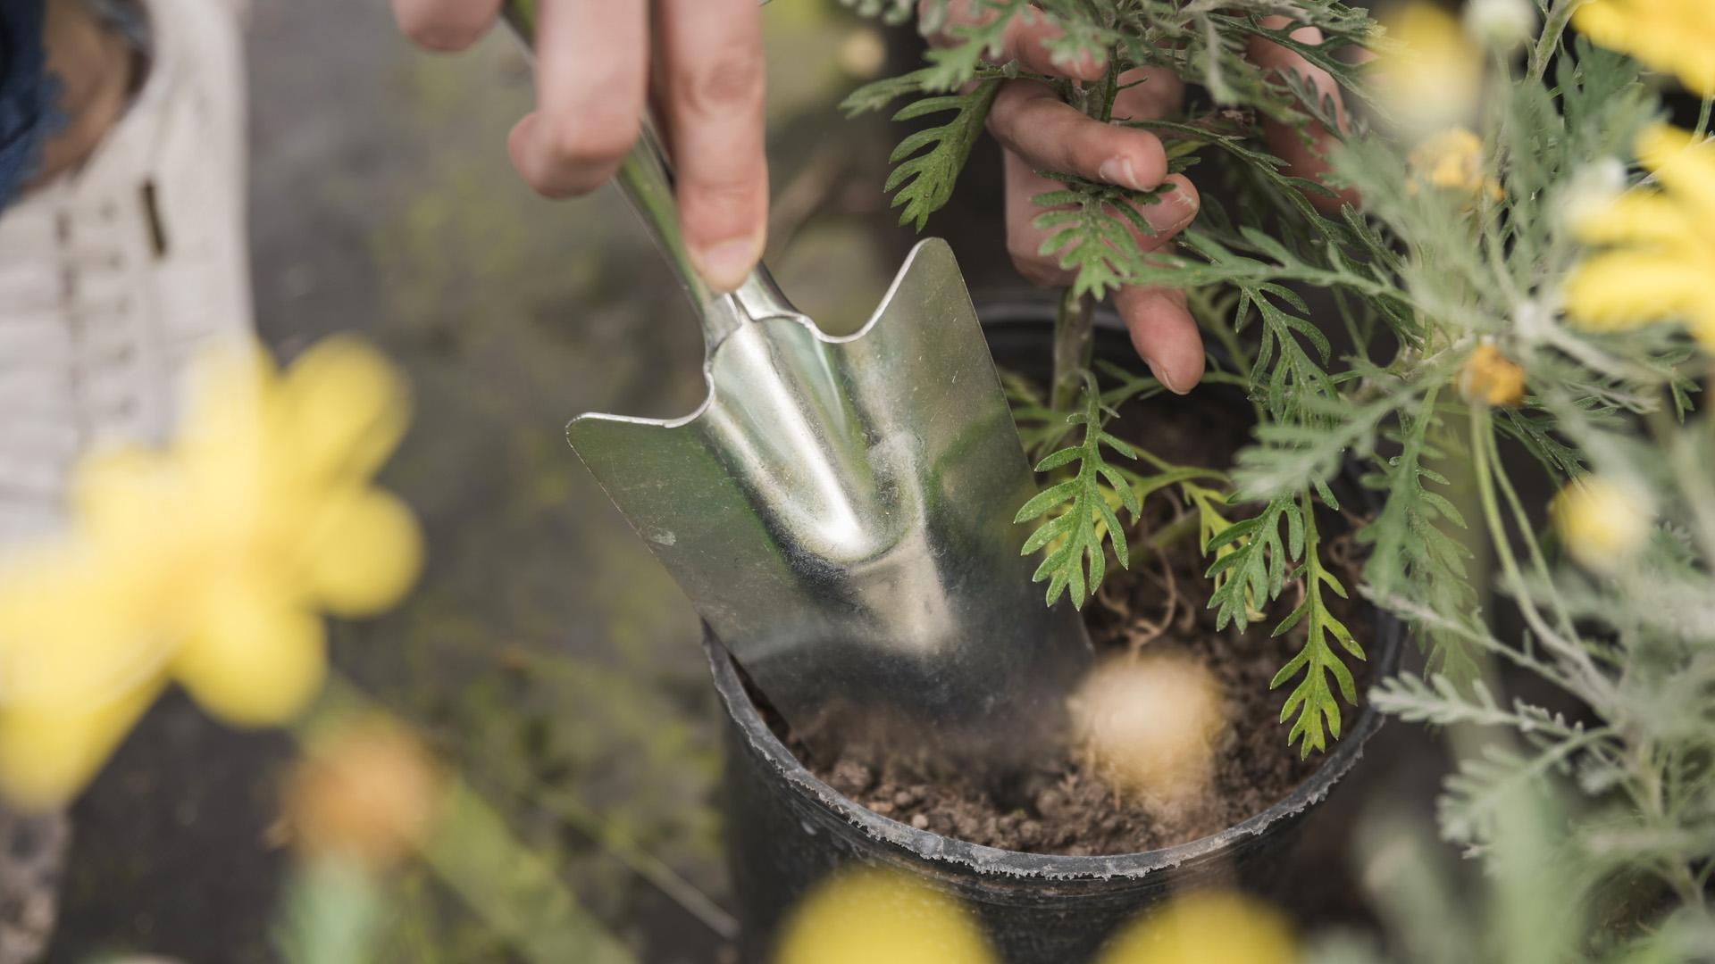
Run some demo

Slide 12
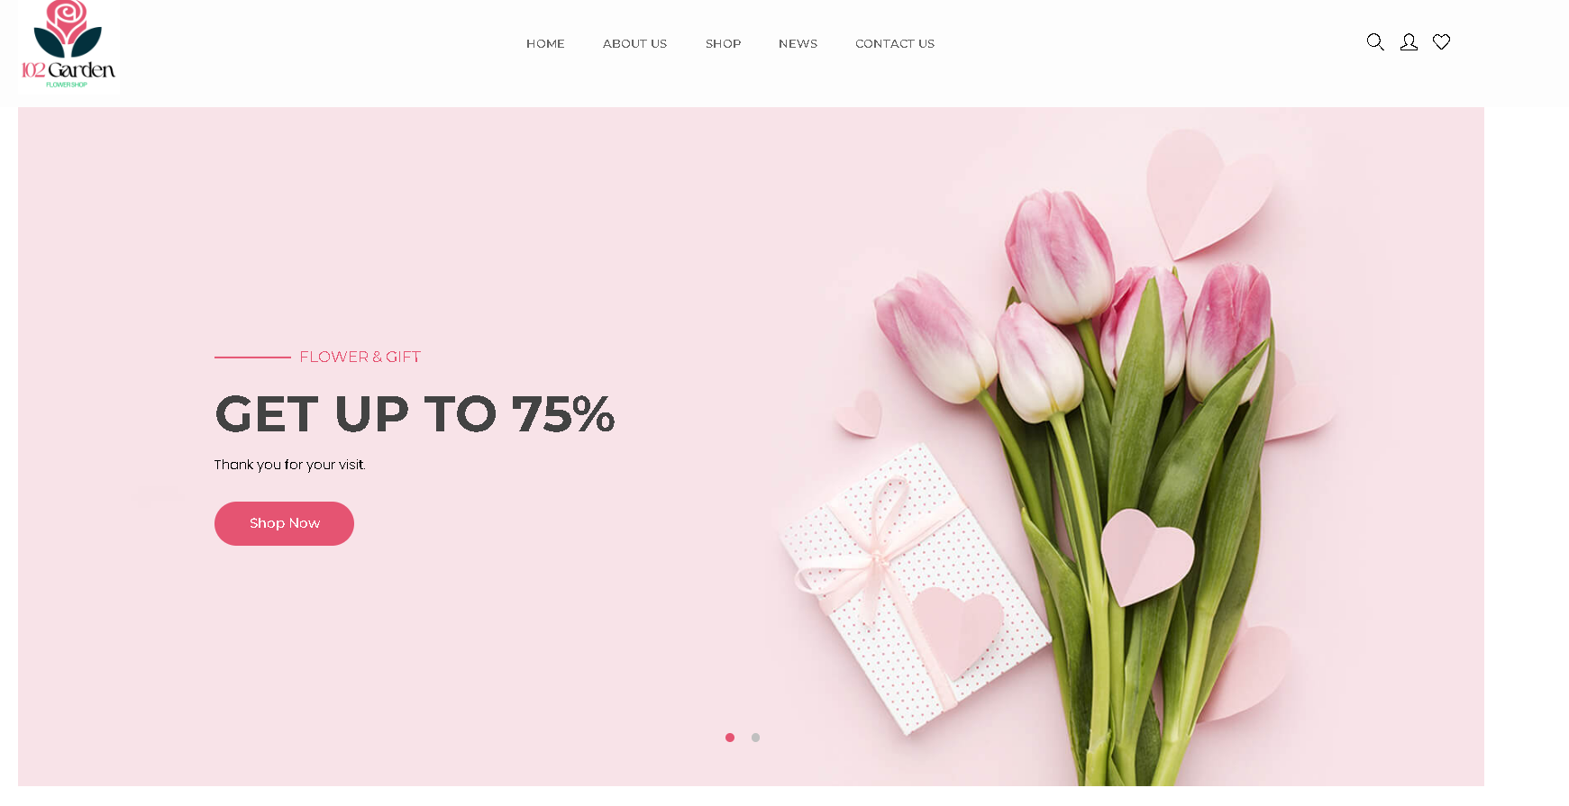
Home page

Slide 13
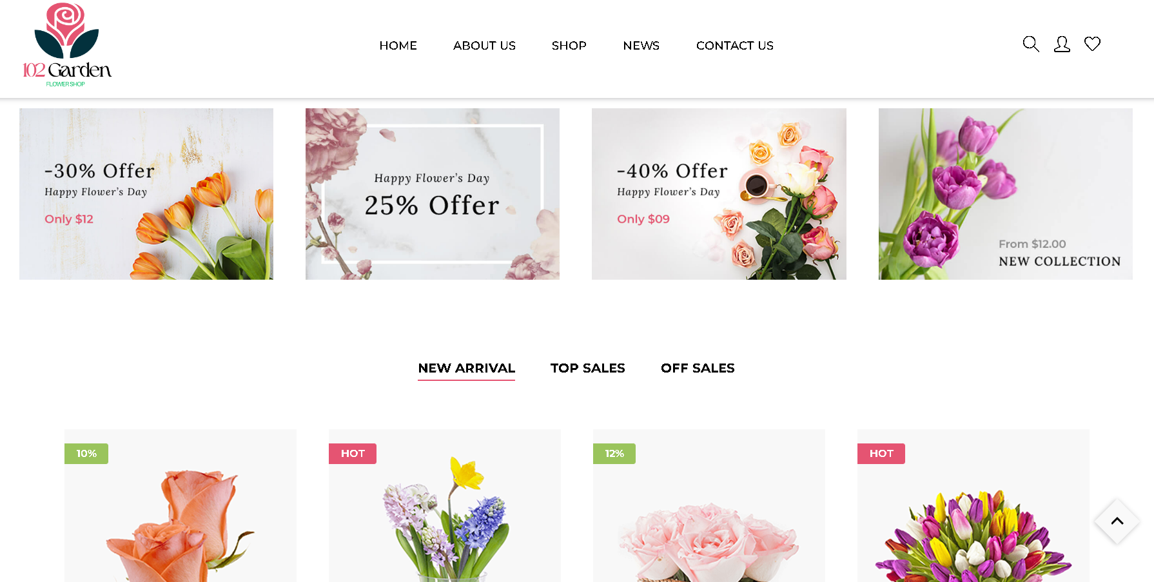
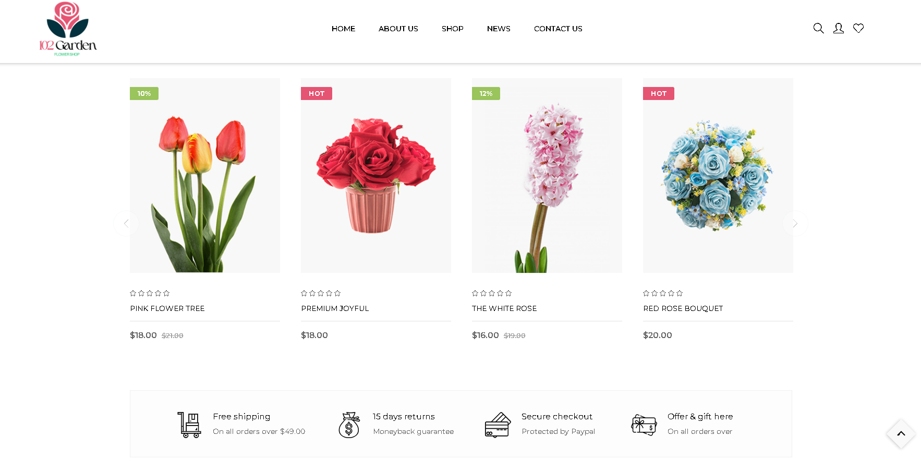
Product site

Slide 14
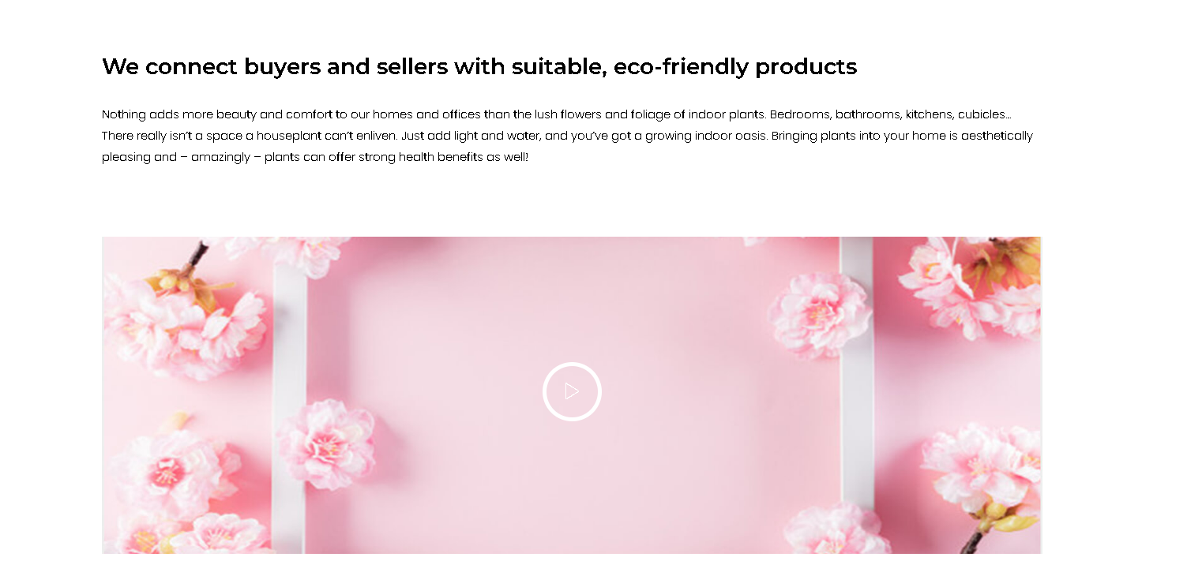
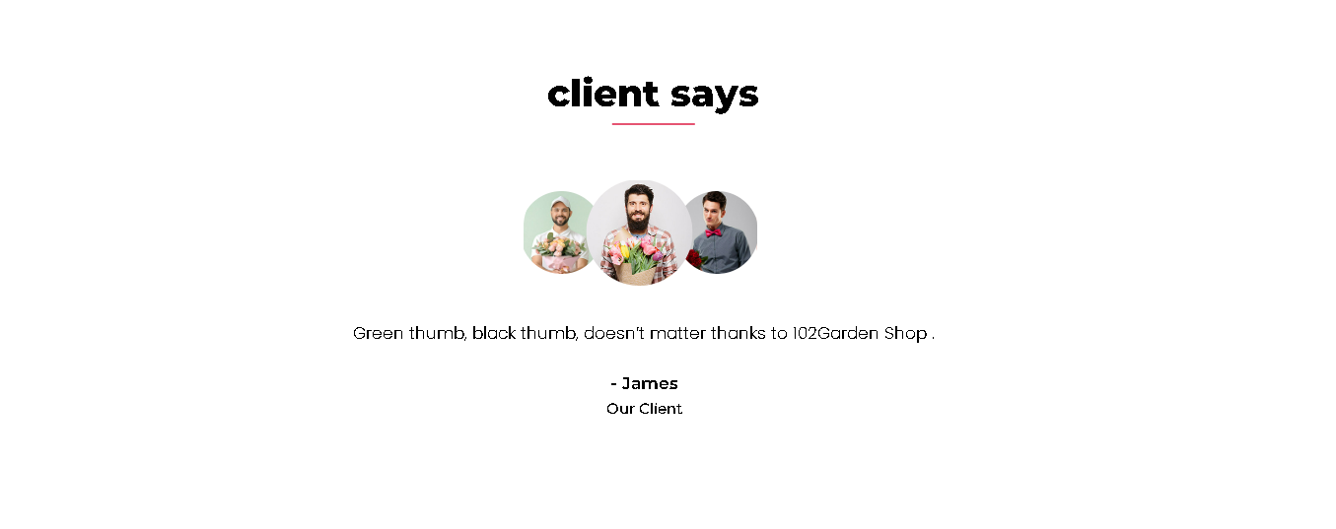
About us

Slide 15
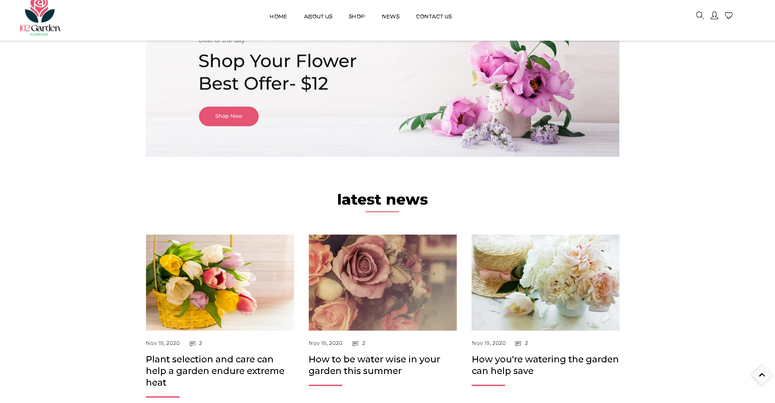
News

Slide 16
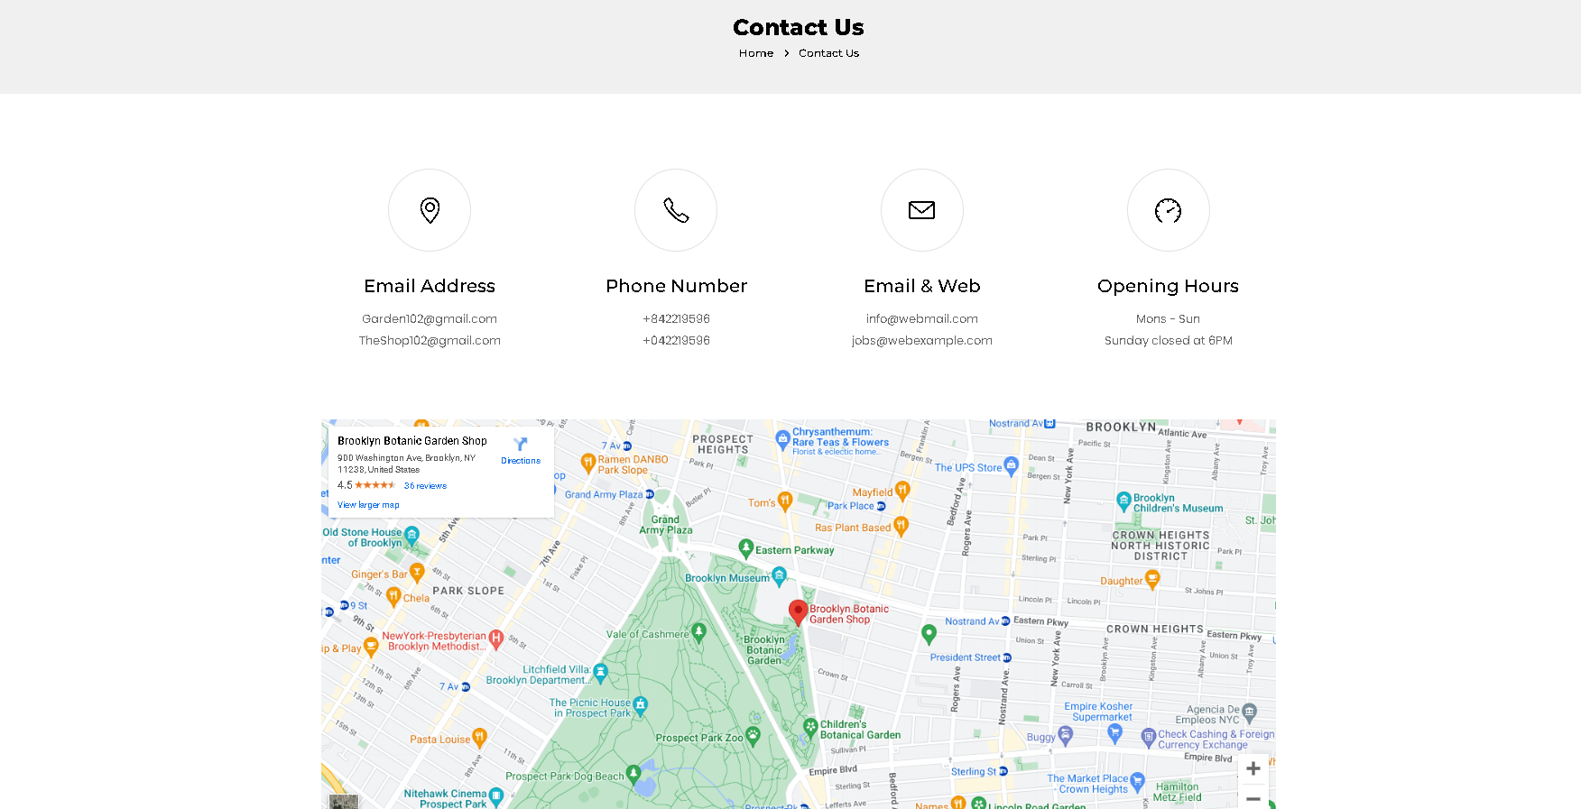
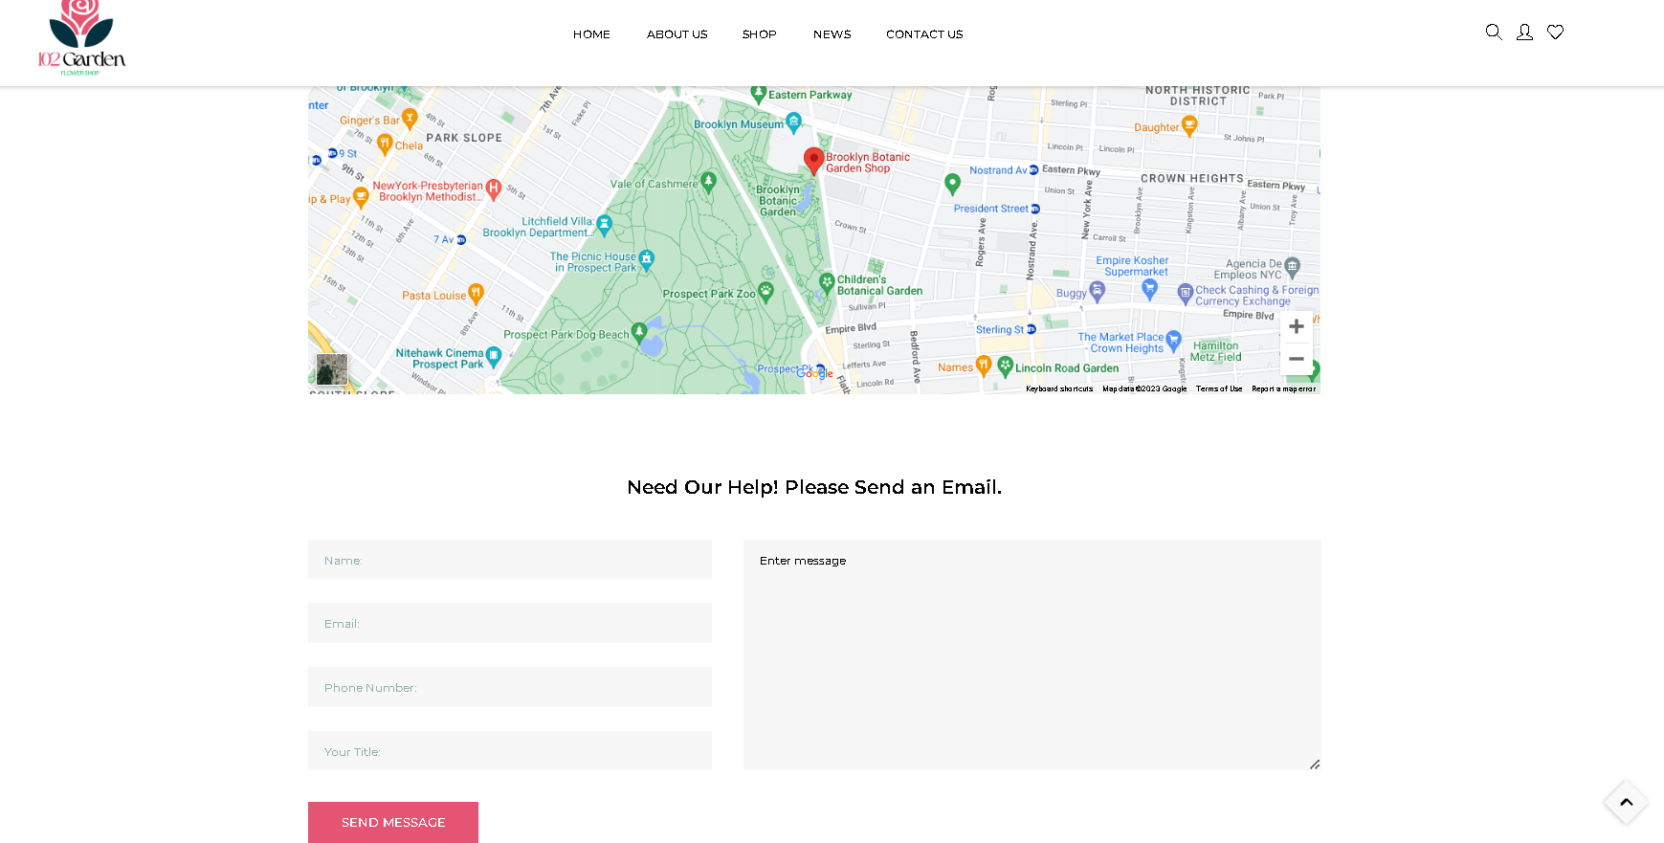
Contact us site

Slide 17
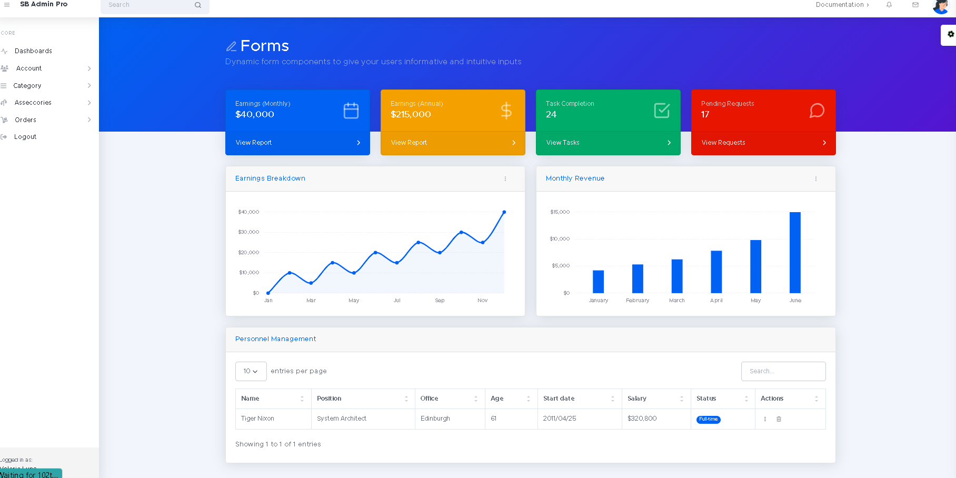
Demo admin
Admin site

Slide 18
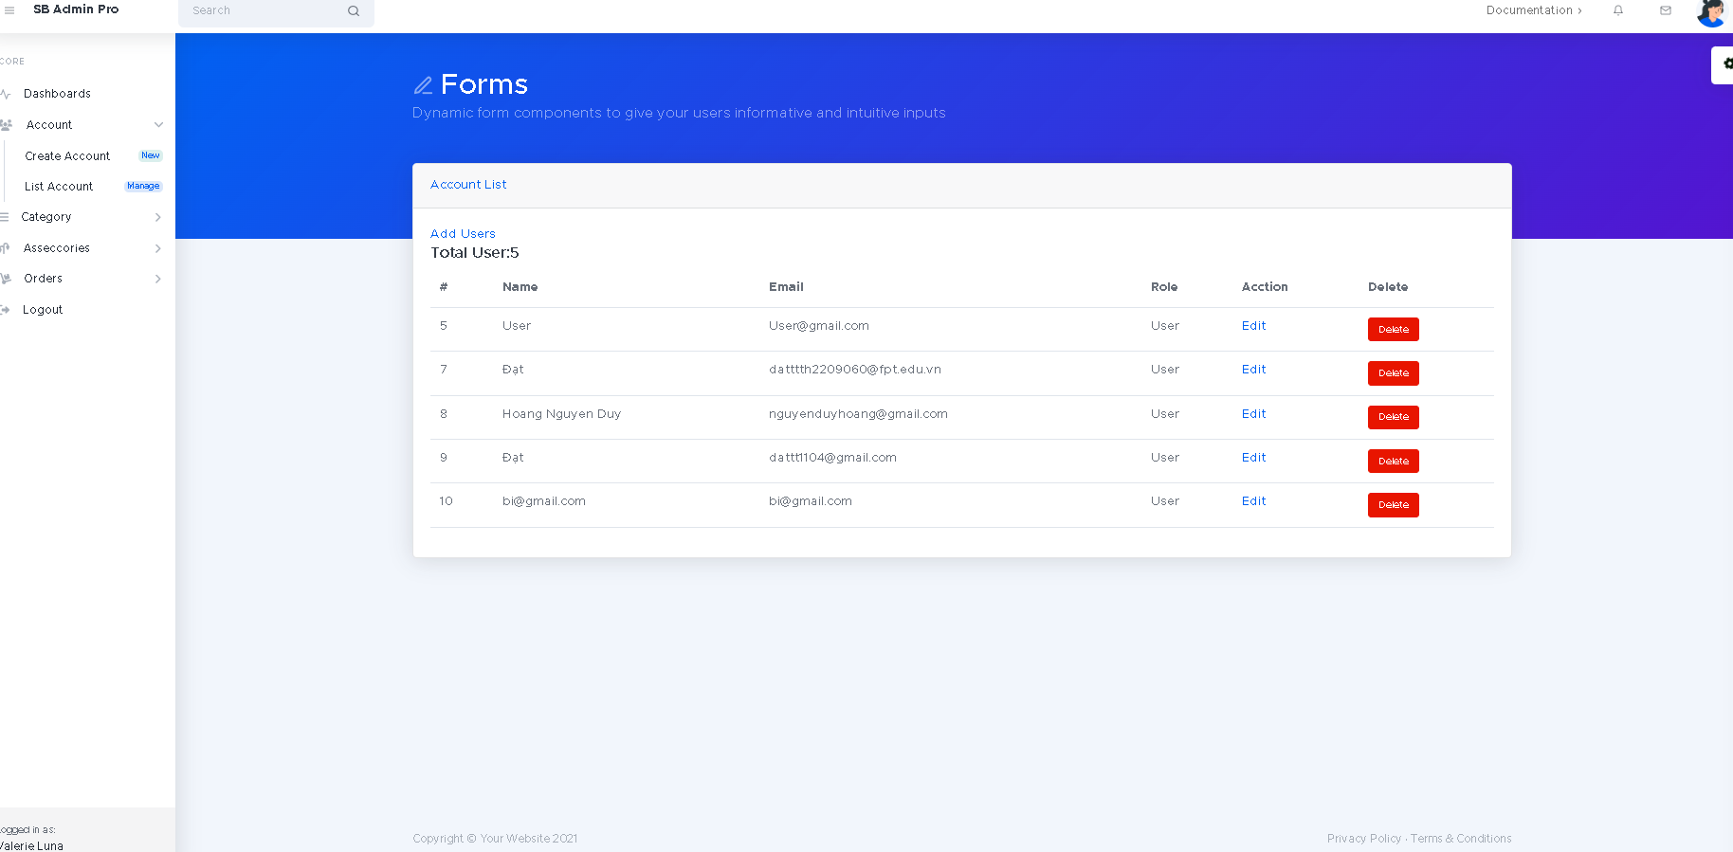
Account management

Slide 19
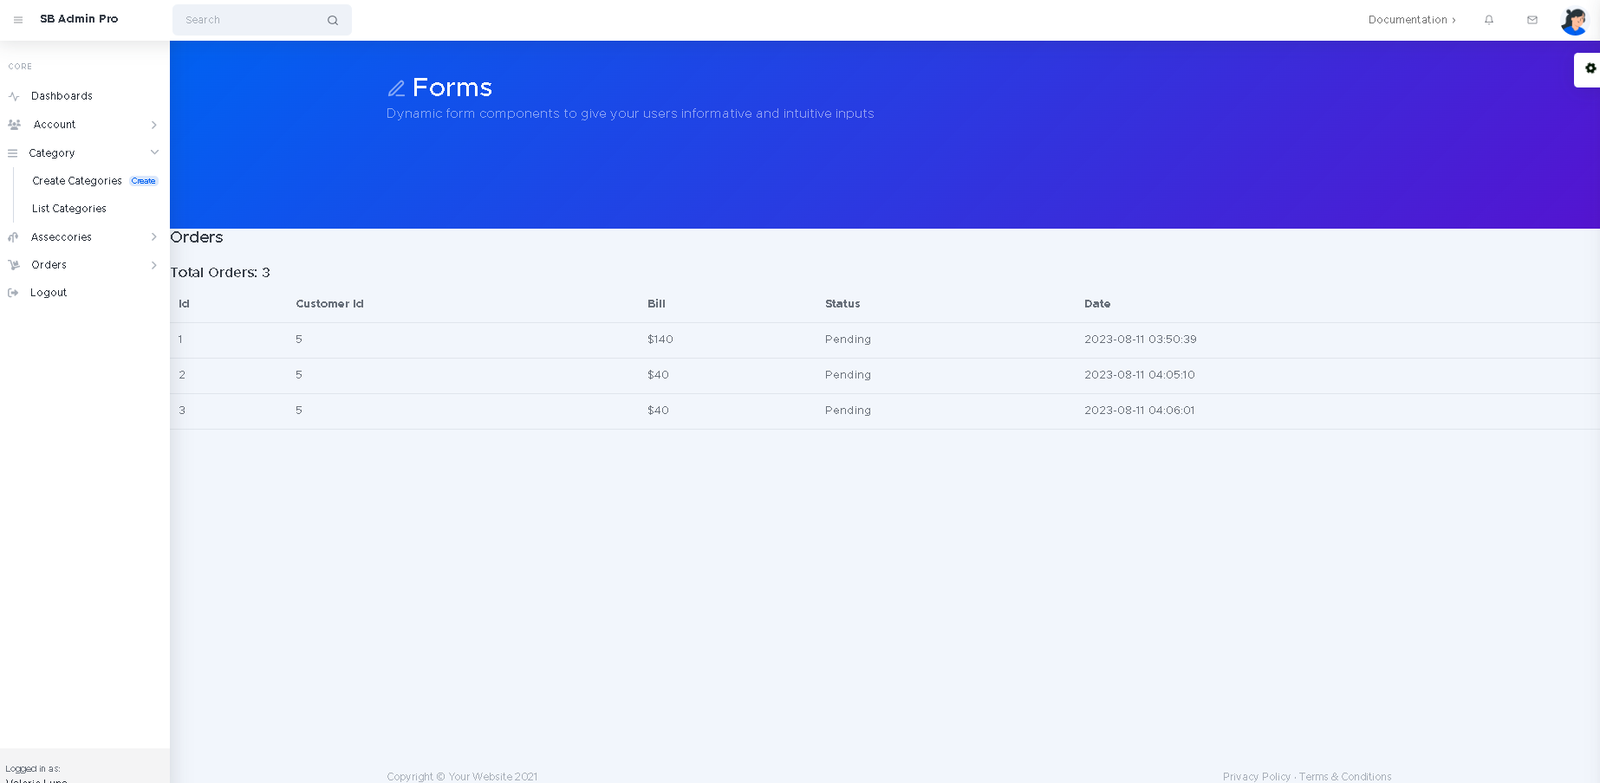
Order management

Slide 20
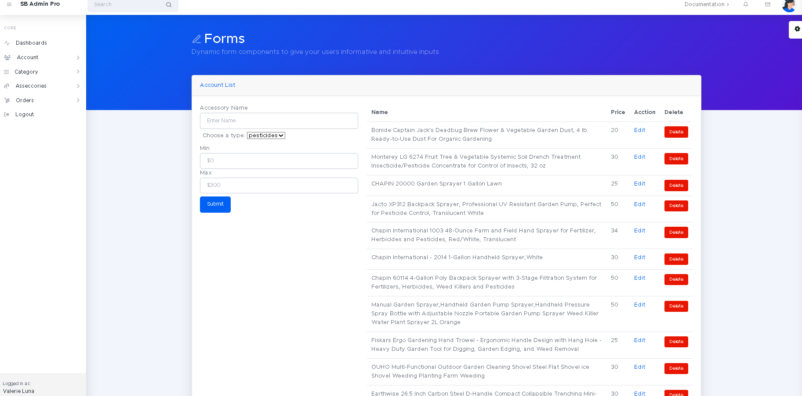
Products management

Slide 21
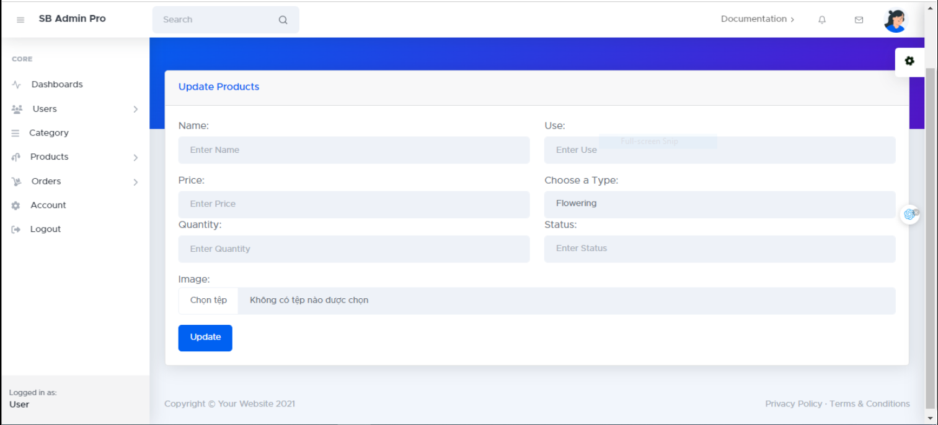
Update products

Slide 22
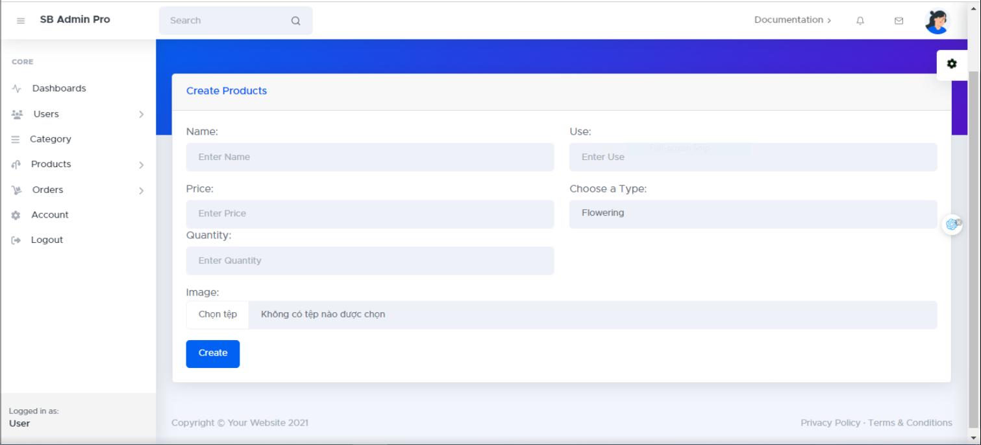
Create products

Slide 23
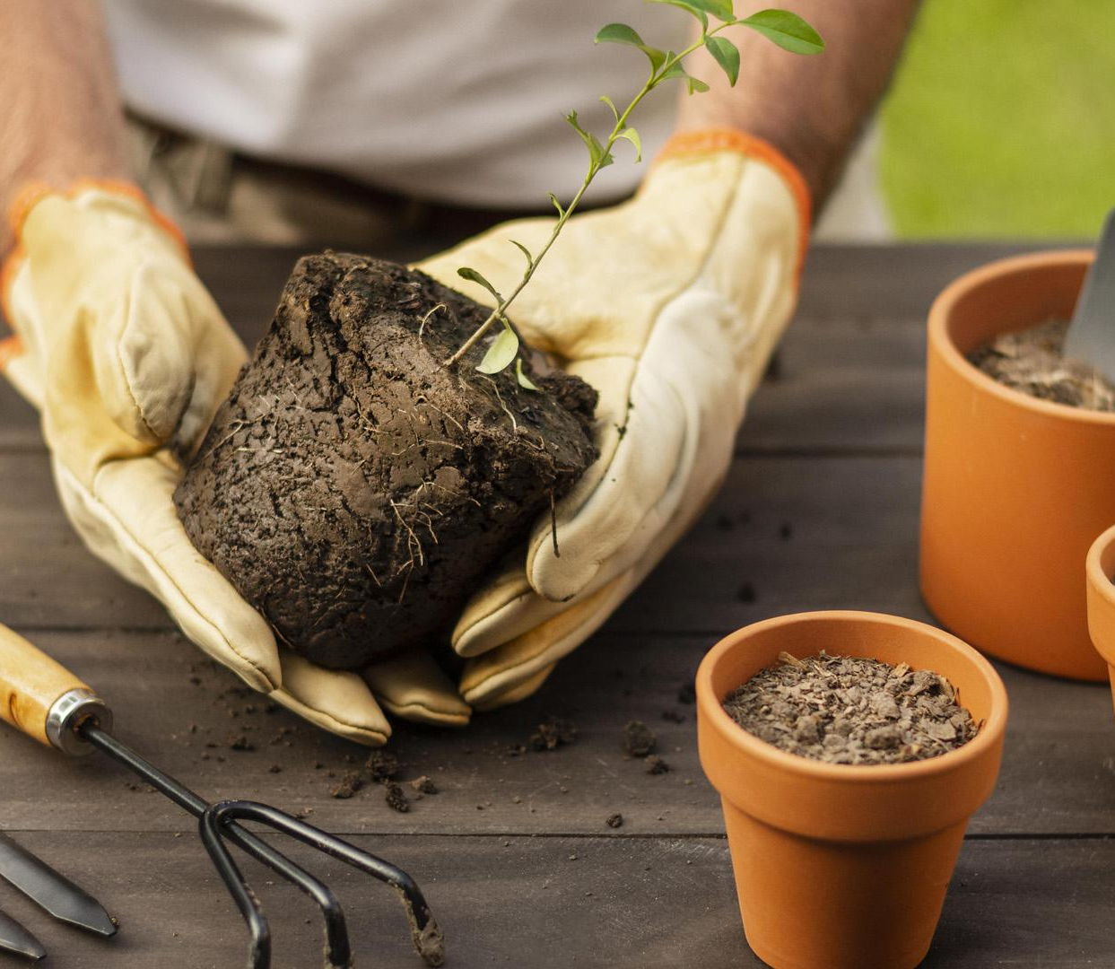
Summary
Why should you choose to use this website ?
1. Easy to use
2. New user friendly
3. Suitable for all ages can

Slide 24


Some drawbacks
Cant recover if lost database
Can’t comment on each product

Slide 25
Improvement in the future
Database
More usage
Create bigger and safer database
Some useful function
Popularity
Extension
More advertising so that more people can know the website
Using API in order to shipping products

Slide 26
Thanks for listening
Do you have any question ?

